Slide 1
Mr. Frederic Salarnier Senior Contracting Officer SHAPE, FINAC
ACO Finance and Acquisition Considerations for Logistics Planning

Slide 2
Outline
Funding Fundamentals
Outsourcing Fundamentals
Planning for Contracted Solutions
Acquisition Planning
Agency Support
Deployment, Sustainment, Redeployment
NATO UNCLASSIFIED

Slide 3
PART I
Funding Fundamentals
Outsourcing Fundamentals
Planning for Contracted Solutions
Acquisition Planning
Agency Support
Deployment, Sustainment, Redeployment
NATO UNCLASSIFIED

Slide 4
Types of Funding
National Funding
Multinational Funding
Through NATO members and/or participating nations
“Costs lie where they fall”
Multinational Funding
Joint Funding
Common Funding
- Salaries of people working in national delegations at NATO HQs (Ambassador, MilRep, Member of the IC, …)
“Bi-/multilateral arrangements outside NATO structure between concerned nations”
“Formal cost sharing mechanism”
“(Collective Budget)” Civil Budget, Military Budget NSIP
- Participating nations identify reqs, priorities, funding levels, and develop a formal cost sharing mechanism. NATO has visibility into these arrangements and often provides political / financial oversight
- Pre-agreed annual ceilings
- Used for international cooperative development projects or cooperative procurements (such as the F-16 aircraft)
- Pre-defined cost shares
- Managed by different Committee consisting of Reps from contributive nations
- In many cases, a NATO Production & Logistics Org is established as part of a Joint Funding arrangement
- Each type has rules and procedures governing how funds may be used
- HQ, NATO C2 systems, ops and exercises, …
Coalition of the willing
Contribution in kind
Trust funds
“Ad-hoc for specific activities”
- Involves typically provision of facilities, capabilities, personnel, special know-how, as opposed to making financial contribution
“Open for non-members”
- Example: Travel & Subsistence Trust Fund within framework of NTM-I
- Programme/project funding

Slide 5

Common Funding Eligibility Criteria
No nation building purpose
= a job for the UN, NGO or IOs
Costs lie where they fall
= overarching principle of NATO common funding This means: If a nation chooses to participate in a mission, the nation is expected to pay its own way for virtually everything related to their participation
Minimum Military Requirement (MMR)
= in NATO, a level of military resources below which, in the opinion of a military commander, operations cannot be successfully initiated, sustained or completed
Costs not attributable to a specific nation
Over and above
IOT be eligible for common funding, a requirement must be deemed to be
“Over” the existing available assets, and also
“Above” reasonable expectations of provision from national resources

Slide 6

Eligibility
= funding issue
= automatically outsourcing issue Eligibility approval and funding needs ratification through
the appropriate committees
Military
Committee
(MC)
Do 30 nations agree:
- to pay for it?
- that it is affordable?
Minimum Military Requirements (MMR)
Resource Policy Planning Board (RPPB)
Eligibility
North Atlantic Council Approves

Slide 7
Eligibility
Article 5
Allied Operation / Mission
Article 5, North Atlantic Treaty
“Collective Defense”
Allied Operation / Mission
Non-Article 5
Allied Operation / Mission
Costs lie, where they fall
Costs lie, where they fall
Operations will be funded on a case by case
basis
Operations will be funded on a case by case
basis
PO (2013)0056
Existing NAC approved
Funding Arrangement Framework
if not included = not eligible

Slide 8

Annual Budget Preparation
Management Board / Command Group
Budget Screening
Draft Budget Pre-Screening at SC level
Final
Budget Production
Preparation
of draft
Budgets
BC screens all Budgets
BC recommends Budget Approval
Budget Guidance issued
NAC
approves
Budgets
Jan
Mar
Apr
Feb
May
Jun
Jul
Aug
Sep
Oct
Nov
Dec
Preparation
Approval
Screening

Slide 9

Annual Budget Execution
Lapsable Credit Report
BC / NAC approves changes (BA2)
BC / NAC approves changes (BA3)
BC screens 1st BER
BC screens 2nd BER
1st Budget Execution Report (BER)
Budget Execution Year begins (BA1)
2nd BER
3rd BER
Jan
Mar
Apr
Feb
May
Jun
Jul
Aug
Sep
Oct
Nov
Dec
BUDGET TRANSACTIONS:
Upload in FinS, Allocation, Freeze/Unfreeze, Delegations, Transfers, Commitments, Carry Forwards, Accruals, Reservations, Expenditures
… Apr Financial Statements produced

Slide 10
PART II
Funding Fundamentals
Outsourcing Fundamentals
Planning for Contracted Solutions
Acquisition Planning
Agency Support
Deployment, Sustainment, Redeployment
NATO UNCLASSIFIED

Slide 11
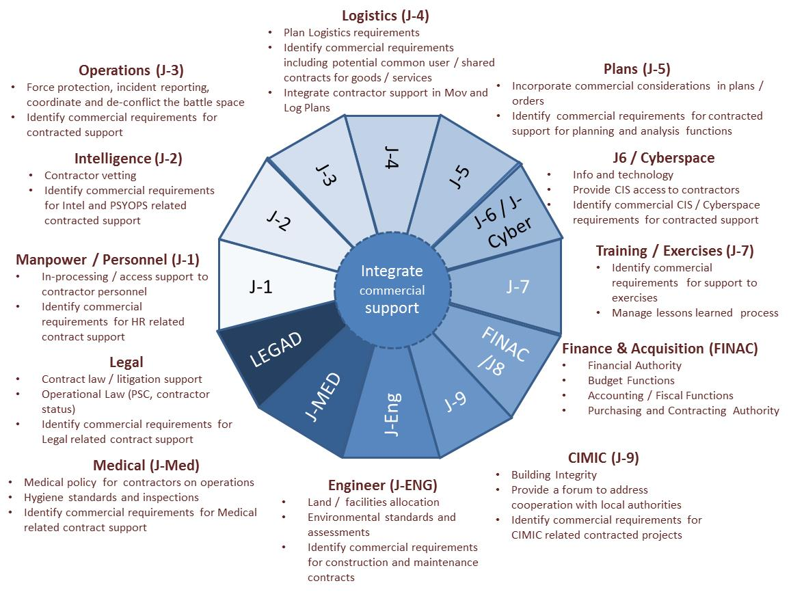
Commercial Support Integration

Slide 12
Overview of Hierarchy Rules
NATO
Financial Regulations
NATO Financial Rules and Procedures
Logistics Doctrine
and Policy
(informs but does not provide execution authority)
Budget Committee Procurement Guidance
or
AC/4-8(21261)1996 (NSIP)
Agency Procurement Directives – Approved by respective ASBs
Bi-SC Procurement Directive 60-70
ACO Directives and
ACO Acquisition Standard Operating Instructions (ASOI)
SHAPE Directives and Local Standard Operating Procedures
| Slide 12

Slide 13
Procurement (NFR)
NFR Article 32.1 NATO Procurement and Contracting shall adhere to the following principles:
(a) The timely acquisition of goods and services to be achieved wherever possible through a competitive bidding process, using approved procurement procedures to achieve the most effective, efficient and economical solution;
(b) Goods and services will be procured, in a transparent and fair manner built upon the principle of non-discrimination and fairness in which eligible suppliers are given the same opportunity and treated in the same fair manner;
(c) Tendering documents shall contain a clear, precise and complete description to enhance full and open competition among eligible suppliers;
(d) Every aspect of the procurement process must conform to the highest standards of integrity and accountability.
| Slide 13

Slide 14
Responsibility and Accountability (FRP)
FRP III 1) continued
f. Purchasing and Contracting Officer(s), to have exclusive legal authority for the procurement of goods and services on behalf of the NATO body. Purchasing and contracting officers should be issued with clear warrants covering their responsibilities, which shall state any limitations on the scope of authority to be exercised.

Slide 15
International Competitive Bidding
84 days: large-scale or complex projects
42 days: other works, supplies and services
Requests for extension: To be submitted not later than 14 days prior to the Bid Closing Date.
NOI sent to National Delegations at NATO HQ
Deviations potentially valid justifications:
urgency,
security,
standardization,
other practical considerations, such as
technical compatibility
legal constraints (i.e. Host Nation law),
insufficient number of qualified bidders
NOI
IFIB Issue
Bidding period
Bid Closing Date
28 or 35 days
42 or 84 days
14 days
Request for extension
28 days
Request for clarification
New BCD
Clarification
28 days
14 days
Last request for clarification

Slide 16
Thresholds / Bidding Requirements

Slide 17
PART III
Funding Fundamentals
Outsourcing Fundamentals
Planning for Contracted Solutions
Acquisition Planning
Agency Support
Deployment, Sustainment, Redeployment
NATO UNCLASSIFIED

Slide 18
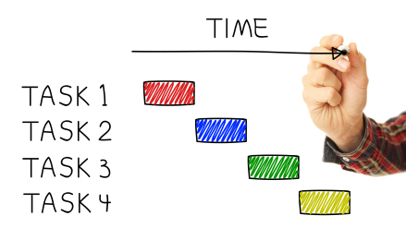
Operational Plan Development
NATO Initiating Directive (NID) Political guidance provided by NAC to SACEUR
Concept of Operations (CONOPS) developed by ACO, approved by NATO HQ
Operational Plan (OPLAN) Military Plan to conduct mission prepared by ACO, approved by NAC (through MC and SRB)
Annex FF and Appendix
- Budgetary assumptions, caveats, req. waivers - Roles of ACO-, JFCs-, Theatre FC
- Appendix covering contracting
Ref.: Bi-SC Directive 60-70, Chapter 6
Concept of Combined Joint Statement of Requirements (CJSOR) List of everything required to execute the mission broken into 3 main categories: National units, TCSOR functions, HQ CEs. Submitted as part of the OPLAN but under SACEUR authority to amend as necessary and force generate with nations
National Units National and Multinational Elements Forces generated by SACEUR where a nation/nations bid to perform a function. These functions are provided entirely at nation’s expense under the “costs lie where they fall” principle. Nations agreeing to do so, have political accepted costs & responsibility for the task. Not eligible for common funding except by exception that must be approved by MC and RPPB on a case by case basis.
TCSOR Theatre Capabilities Statement of Reqs Functions normally filled by a nation/nations deemed by the Cdr as a Theatre Capability. Performed by either a LN or by NATO as the LN, included in CJSOR but identified for additional approval by the nations subject to MC and RPPB endorsement for eligibility for common funding. Note not everything on the TCSOR will be common funded. If deemed eligible, the LN can get the in-theatre operating cost reimbursed. If NATO lead, the operating costs will be paid directly by NATO.
HQ & CE NATO command Structure HQ Limited to Theatre HQ and designated NATO Command Element. Command Structure for mission identified in the OPLAN and approved by nations. MC and RPPB determine the number of command elements for each mission. SACEUR has the authority to determine the number of personnel at each. Military personnel are force generate by SHAPE and the cost for civilian posts are submitted with the annual budget to the BC.
NO COMMON FUNDING
SOME COMMON FUNDING
MOSTLY COMMON FUNDED

Slide 19
Outsourcing Only One Option
Strategic
Contract Enablement Planning
Warning
Phase
With NAC Approved OPLAN
Execution
Host Nation
Nation
Provides - may include National contracts
Establish rapidly usable contractual mechanisms
Force
Generation
Assessment
Force Generation
CJSOR
Nation Provides
Build readiness awareness of National Commercial Capabilities
Develop / Confirm
Mission Specific
Requirements
COA Analysis to include potential outsourcing
CONOPS
Force Generation
TCSOR
Lead Nation Provides Military or CSO
Establish Cross Servicing Agreements / Mechanisms
If common Funded
MC / RPPB
Activation of Rapidly
Usable Enabling Contracts
Planning Input
NATO Agencies
Encourage & Support Multinational Partnerships
Outsourced
Common Funded MC/RPPB business case
In-house contract
Multinational solution through a national contract, national/ NATO agencies e.g. APOD

Slide 20
DECISION TO OUSOURCE
Minimum Military Requirement
Force Generation
failure anticipated
No Nation willling to be Lead Specialist Nation
Affordable costs
BusinessCase
Strategy
defines
Option
Common Funded MC/RPPB business case*
NATIONS take the decision
NAC Approval
Outsourcing
Direct Industry
Procure through
an Agency
or
RUEC
Inhouse
RUEC
Inhouse
Outsourcing = Rules Apply

Slide 21
DECISION TO OUSOURCE TO INDUSTRY
Minimum Military Requirement
Force Generation
failure anticipated
No Nation willling to be Lead Specialist Nation
Affordable costs
Common Funded MC/RPPB business case*
Committee Approval
NATIONS take the decision
ACO enters into a commercial relationship with supplier
NAC Approval
ACO entity (Budget Holder) sources supplier following
NFR and applicable Procurement Regulations
Contractual instrument
Creates Liability
Nations (NATO) assume (s) liability and associated risk

Slide 22
DECISION TO OUSOURCE TO AGENCY
Minimum Military Requirement
Force Generation
failure anticipated
No Nation willling to be Lead Specialist Nation
Affordable costs
Most efficient, effective ,economical mean
Common Funded MC/RPPB business case*
Committee Approval
NATIONS take the decision
NAC Approval
SHAPE representing ACO implements agreement
Agreement
ACO enters into a NATO Agency Agreement
Creates Liability
Nations (NATO) assume (s) liability and associated risk

Slide 23


NATO Agencies Support to AOMs
1) Primarily two NATO agencies support AOM
NATO Communications and Information Agencies (NCIA)
NATO Supply and Procurement Agency (NSPA)
2) Procuring through an Agency is done either by
a. NATO on common funding = 30 Nation Decision
b. Nations independently (Bi- or Multi-laterally)
Notes:
23

Slide 24
Customer Funded Agencies
Agencies do not have their own funds / common funded budget allocation
Agencies receive minor funds for the corporate structure (board and General Manager)
All administrative and operational costs are borne by their customers
Customers must accept all financial costs, risks and liabilities for any task given to the agency
Agencies have no capability without paying customers
Notes:
24

Slide 25
Three Tier Framework for Procuring Services from NATO Agencies
Overarching
Authorizing Agreement
Programme / Project Agreements
Funding and Contractual Commitment
Memorandum of
Agreement (MOA)
Logistics Support Agreements (LSA) with NSPA & Service Level Agreements (SLA) with NCIA
Purchase Orders
Principles of how the Parties will work together
General agreement on service areas (what programs, projects etc…)
the general terms and conditions agreeing, managing and funding specific tasks
Specific deliverables and associated key performance indicators.
Specific instructions regarding the modification, extension or termination of contracts
Terms and conditions on finance and accounting
Reporting instructions
Formally obligates funds
Can be multi-year if contract authority was obtained from Budget Committee
Can be adjusted in-year
Single function or multi-function
In Level of budgetary detail can vary based on the function covered in the PO.
No Expiry Unless
Agency Ends
Limited to the duration
of Operation or Project
Valid until funds consumed or budget expires

Slide 26
- Rapidly Useable Enabling Contracts -
(RUEC)
“RUECs are tailored, pre-planned time and mission critical logistics, infrastructure/engineering and medical contracts, at variable readiness that can be used by NATO and nations on AOM and exercises. Each RUEC is unique depending upon the contractual support required and level of readiness and risks involved to meet an ACO endorsed operational requirement.”
Multi-Modal Transportation (in-house and one with NSPA linked to Deployment of CPs)
Real Life Support linked to Deployment of Camps (CPs) (NSPA)
Out of Area Fuel (NSPA)
Strategic Medical Evacuation Airlift (NSPA)

Slide 27
- Assured Access Contracts -
No definition has been agreed on the term Assured Access as it typically refers to access from a security perspective and not to contracts.
It has become a common descriptive term describing the desired effect of a contract whereas it is not a type of contract.
“A contract that provides assured access to a service to be provided by the contractor during a defined period of time and at agreed terms, conditions and prices. For assuring the availability of a service if and when needed, the customer agrees to pay a fee to the contractor irrespective of whether or not the service is activated”

Slide 28
Challenge - Rapidly Usable Enabling Contracts
Full Assured
Access Contracts
No magic moves
No magic contracts
Limited Assured
Access Contracts
+
Cost
-
Basic Ordering
Agreements
w/ minimum
Basic Contractual
Instruments
- Time +

Slide 29
Sustainment & Redeployment
Sustainment normally means transition to commercial support as the security environment improves
same process for outsourcing (MMR, eligibility)
Sourcing (business case options)
Transition to different mission considerations - Host Nation status…
End of Mission – Contract work continues after end of mission

Slide 30
Take Away
30 Nations are sovereign and they make the rules
Common funding is not the default solution
Eligibility drives common funding
Earlier identified the better…
Procurement Rules part of Financial Rules
Outsourcing – not default and sourcing is an acquisition decision.
Agencies – Customer funded, customer accepts all financial implications.
Plan for sustainment, redeployment and beyond...
NATO UNCLASSIFIED

Slide 31

QUESTIONS?
Notes:
(SLIDE 12)

